Slide 1
Dansville Police Department Police Reform 2020-2021

Slide 2
June 2020:
Executive Order No. 203:
New York State Police Reform and Reinvention Collaborative Plan

Slide 3
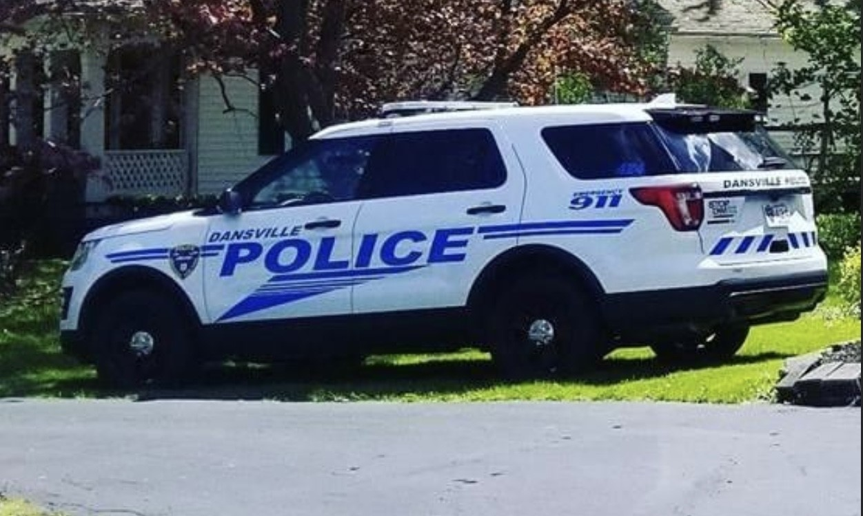
Dansville Police Department Mission Statement
The mission of the Dansville Police Department is to maximize the quality of life of the citizens of the village we serve; to uphold the law fairly and firmly; to prevent crime; to pursue and bring justice to those who violate the law; to keep the peace in the village; to protect and help all people in the Village of Dansville; to do all this with integrity, common sense, and sound judgment.
We will strive to provide the best service we can in meeting the needs of this growing Village.

Slide 4
Table of Contents:
I. Introduction
Department Profile
Municipality Demographics
Agency Demographics
II. Reform & Reinvention Collaboration Process
Collaborative Approach
Opt-in Partners
Team Leadership
Process Implementation Approach & Timeline

Slide 5
Table of Contents:
III. Public Participation & Feedback Channels
Community Stakeholder Groups
Listening Sessions
Surveys
IV. Dansville Police Department Police Reform Plan
New York State Mandates
Dansville Police Department Reforms

Slide 6
Table of Contents:
IV. Dansville Police Department Police Reform Plan
New York State Mandates
Dansville Police Department Resolution on Police Reform

Slide 7
NYS Executive Order No. 203
On June 12, 2020, Governor A. Cuomo issued an executive order directing municipalities that employ police officers to actively engage stakeholders in the local community and develop locally approved plans for the strategies, policies and In accordance with this order, the Dansville Police Department created a process to enact police reform plans.

Slide 8
Introduction: Department Profile
Municipality: Village of Dansville
Law Enforcement Agency: Dansville Police Department
Village of Dansville Executive Officer: Peter Vogt, Village Mayor
Dansville Police Department: Sergeant Shannon D. Griese

Slide 9
Introduction: Municipality Demographics
According to the United States Census Bureau, the village of Dansville has a total area of 2.6 square miles and all of it recorded as land. The village sits in a glacially formed valley, common throughout western New York. The Canaseraga Creek flows northward just west of the village limits; it is a tributary of the Genesee River. Interstate 390, New York State Route 36, New York State Route 63, New York State Route 256, and New York State Route 436 pass through the village. It is bordered to the northwest by the unincorporated community of Cumminsville. Geneseo, the Livingston county seat, is 18 miles to the northwest, Hornell is 17 miles to the south, Corning is 51 miles to the southeast, and Rochester is 44 to 53 miles to the north, depending on which highway one takes. Stony Brook State Park, with waterfalls, hiking, and swimming, is 3 miles south of the village.
As of the census of 2000, there were 4,832 people, 1,976 households, and 1,246 families residing in the village. The population density was 2,042.4 people per square mile. There were 2,090 housing units at an average density of 883.4 per square mile. The racial makeup of the village was 95.78% White, 1.26% African American, 0.23% Native American, 0.66% Asian, 1.30% from other races, and 0.77% from two or more races. Hispanic or Latino of any race were 2.07% of the population.

Slide 10
Introduction: Municipality Demographics
In the village, the population was spread out, with 26.7% under the age of 18, 8.7% from 18 to 24, 27.5% from 25 to 44, 21.3% from 45 to 64, and 15.7% who were 65 years of age or older. The median age was 37 years. For every 100 females, there were 90.1 males. For every 100 females age 18 and over, there were 86.2 males.
The median income for a household in the village was $32,903, and the median income for a family was $41,519. Males had a median income of $31,699 versus $25,256 for females. The per capita income for the village was $15,994. About 12.3% of families and 17.0% of the population were below the poverty line, including 17.3% of those under age 18 and 11.7% of those age 65 or over.

Slide 11
Introduction: Agency Demographics
The Dansville Police Department consists of 12 employees:
0-1 Police Chief
1-1 Sergeant
4-6 Full Time Officers
6-10 Part Time Officers
1-2 Civilian Clerks
Males, 9 Caucasian , Females 3 Caucasian

Slide 12
Reform & Reinvention Collaboration Process : Collaboration Opt – in Approach
The Dansville Police department worked with an opt-in approach with a variety of agencies, companies and village residents
Opt – in Agency Partners:
Village of Dansville Board
Dansville Police Department
Livingston County District Attorneys Office
Livingston County Public Defenders Office
Business Owners
Clergy Members
Health Care Workers
Private Attorneys
Village Residents
Youth Member

Slide 13
Reform & Reinvention Collaboration Process : Team Leadership
Team Members:
Peter Vogt, Village of Dansville Mayor
Shannon Griese, Dansville Police Department Sergeant
Larry Burley, Council 82 Union President (Dansville Police Department)
Greg McCaffrey, Livingston County District Attorney
Lindsay Quintilone, Livingston County Public Defenders Office
Jenni Leuzzi, Business Owner
Derek Wadsworth, Clergy Member
Lou Colella, Private Attorney
Sherry Innocent, Health Care Worker
Jane Schryver, Village Resident
Paul Hoffman, Village Resident
Larry Brockington, Village Resident
Makayla Cox, Youth Member

Slide 14
Process Implementation Approach & Timeline Phase 1 (November-December)
Objectives:
Ensure that scope of review is determined by PRC members of the public, not
village officials
Ensure confidentiality and candid dialogue
Ensure productive and efficient collaboration
Provide a foundation for broader community discourse in Phase Two
Actions:
Establish initial scope of review
Develop preliminary findings and recommendations
Release preliminary findings and recommendations to the community
Organize necessary documentation to support community forums in Phase Two

Slide 15
Process Implementation Approach & Timeline Phase 2 (January- February 2021)
Objectives:
Shared understanding of existing local systems (governance structure,
policies, practices, systems of accountability and responsibility, etc.)
Allow for public participation in identifying gaps and proposing solutions
Invite community partners (nonprofits, businesses, individuals)
Transition responsibility from public to Village Board of Trustees
Actions:
Share preliminary findings and recommendations
Confirm (or expand) scope of review
Identify areas that require community and individual action (If any are needed)
Identify areas that require action from the Village Board (If any are needed)

Slide 16
Process Implementation Approach & Timeline Phase 3 (February-March 2021)
Objectives:
Ensure the Village Board can process with understanding of residents’ desires
Ensure clarity of purpose for Village’s action plan
Promote community commitment to racial equity
Actions:
Prioritize key policies changes (If any are needed)
Identify necessary budget adjustments
Establish timelines for implementation
Release draft action plan and invite further feedback from public
Ratify action plan by April 2021

Slide 17
Public Participation & Feedback Channels: Community Stakeholder Groups
Community Team Members: (13 key stakeholder participants)
Dansville Police Department
Dansville and Livingston County Elected & Appointed Officials
Representatives from Dansville Nonprofit Organizations, Healthcare Organizations, Clergy, Businesses and youth members,
Citizens who represent marginalized populations

Slide 18
Public Participation & Feedback Channels: Listening Sessions
Conducted in person and advertised on social media and website
2 Public Sessions open to all Village of Dansville Residents
6 Private in person workshop sessions were held

Slide 19
Public Participation & Feedback Channels: General Public Survey:
22 survey questions for all village residents with 84 participant responses
12 survey questions for all Dansville School District Students with 348 participant responses
Results posted for public viewing on social media and local website

Slide 20
Dansville Police Department Reform Plan
The reform plan, in accordance with public feedback and the executive order requirements consists of five primary themes:
NYS Mandated Changes
Equality and Social Justice
Transparency and Accountability
Community Relations
Department Operations
Update Department Policies and Procedures yearly
Yearly updated and refresher training for all officers

Slide 21
DPD Reform Plan Community Relations
Category | Reform Item | Description | Reform Action | Completion Timeline
Community Relations | CR-1. Conduct Public Education on Policing Practices | Increase the transparency of policing methods and governance by educating the public on these practices. | 1. Provide brochures to share recommended actions for citizens when interacting with police. | Nov - 2022
Community Relations | CR-2. Strengthen Customer Service Practices | Reinforce need for positive communications through better customer service & professional development training. Develop a quality assurance program to identify how citizens perceive the DPD customer service. | Develop & conduct Professional Development training on communications for Supervisors Develop & conduct best practice communication trainings Village- wide: Positive & effective customer service Best practices for general communications | Feb - 2023 Jan - 2024

Slide 22
DPD Reform Plan Community Relations II
Category | Reform Item | Description | Reform Action | Completion Timeline
Community Relations | CR-3. Strengthen Community Safety Training Programs | Partner with ambulance volunteer instructors to provide key CPR/AED training that are provided to residents or community groups and improve offerings. These trainings help enhance their knowledge and support better community relations. | Team with Ambulance instructors to continue conducting CPR/AED courses for members of the community. Team with School for "Bike Rodeo" twice a year. Assist with any community events | April 2021
Community Relations | CR-4. Establish & Promote Community Programs to Increase Law Enforcement Visibility in the Community | Develop and execute programs that bring law enforcement officers and citizens together in forums where they talk to one another, share thoughts, and promote interactions which support the building of positive relationships. Further promote the Department of Homeland Security’s CRASE training (Citizen Response to Active Shooter Event) and Stop the Bleed training (an emergency medical response training for catastrophic injuries) | Create new interactive programs: “Park Walk and Talk” program for officers to interact personally with citizen groups “Coffee with the Chief/Mayor” monthly social hour or gatherings for faith-based groups and community action groups to interact with the DPD and Village | April - 2021

Slide 23
DPD Reform Plan Transparency & Accountability
Category
Reform Item
Description
Reform Action
Completion
Timeline
Transparency &
Sept
-
202
TA
2
-
Accountability
1
. Reduce
Identify key behaviors & causes that
1. Train field training officers to
Personnel Complaints
may drive citizens to
complain about
review complaints and determine
& Adopt Reporting
officers and incorporate these
needed focus areas & changes in
Method
findings into trainings.
trainings
& Tracking
Jan
Work to align village agencies to
2.
Establish a standardized personnel
-
2022
adopt a
standardized personnel
complaint process
Village
-
complaint process. Develop a
wide
3.
Develop a Village
-
Village
wide tracking
-
wide tracking system of
Jan
complaints.
system to assist in identifying training
-
2022
needs.
Transparency &
TA
-
2
. Increase
Ensure better and timely citizen
Jan
Accountability
transparency of Use
access to use of force data and
1.
Add annual report data fields in
-
2021
of Force Incidents
personnel complaint incidents and
current system
for:
& Personnel
outcomes. Modify current DPD
a)
Use of Force (type & frequency)
Complaints
software systems to better collect
b)
Personnel Complaints
and
and track this data.
adjudications
Transparency &
TA
-
3
. Publish Job
Make job descriptions and
1. Post job descriptions of DPD
May
Accountability
Descriptions and
performance process more readily
-
2021
Annual Performance
available to improve transparency.
personnel (Chief,
Sergeant, Officers)
Appraisal Process
and performance appraisal document
on DPD website.

Slide 24
DPD Reform Plan Transparency & Accountability II
Category | Reform Item | Description | Reform Action | Completion Timeline
Transparency & Accountability | TA-4. Increase Transparency of Arrest Activities & Calls for service | Ensure citizens have access to appropriate police data & arrest activities via a monthly report placed on the Village of Dansville website | Publish these monthly reports: Calls for service, arrests, and use of force incidents Arrests by gender and race. | Jan - 2021

Slide 25
DPD Reform Plan Operational Policies & Procedures
Category
Reform Item
Description
Reform Action
Completion
Timeline
Operational
OPR
-
1. Initiate
Allow citizens & officers to submit
Oct
1. Establish a process for citizens and/or
-
202
1
Policies &
Anonymous Quality
feedback via website to the
Village of
officers to engage with the Village of Dansville
Procedures
Assurance Feedback
Dansville. This could be positive or
website anonymously notify Village officials of
Channels
negative
positive or unsatisfactory behavior of
personnel.
Operational
OPR
-
2. Pursue
Assess current policy and procedures
Nov
1.
Conduct a comprehensive review of
current
-
2023
Policies &
NYS DCJS Law
to determine areas of non
-
compliance
DPD policies against these state level standards
Procedures
Enforcement
in order to meet NYS DCJS Law
to identify gaps and attain NYS accreditation.
Accreditation
(LEAP)
Enforcement Accreditation standards.

Slide 26
Resolution on Police Reform
Whereas, the Village of Dansville wishes to comply with New York State Executive Law No. 203, New York State Police Reform and Reinvention Collaboration, signed by Governor Andrew Cuomo on June 12, 2020;
Whereas, Executive Law No. 203 states that immediate action is needed to eliminate racial inequities in policing, to modify and modernize policing strategies, policies, procedures, and practices, and to develop practices to better address the particular needs of communities of color to promote public safety, improve community engagement, and foster trust;
Whereas, government has a responsibility to ensure that all citizens are treated equally, fairly, and justly before the law;

Slide 27
Resolution on Police Reform
Whereas, the Village of Dansville has an operating police agency with police officers as defined under 1.20 of the criminal procedure law;
Whereas, the Village of Dansville’s Police Department has implementation of policies and procedures that are conceptually sound and operationally effective.
Whereas, the chief executive of the Village of Dansville has met with stakeholders in the community including membership and the leadership of the local police force; members of the community; interested non-profits and faith-based community groups; the local office of the district attorney; the public defender; and local elected officials;

Slide 28
Resolution on Police Reform
Whereas, the Village of Dansville has performed a review of current police force policies, procedures, and practices, and has made modifications to improve such policies, procedures, practices, accountability and transparency for the purpose of addressing the particular needs of the Village of Dansville community and to promote community engagement to foster greater trust, fairness, and legitimacy, and to address any racial bias and disproportionate policing of communities of color;
Whereas, the community stakeholders in order to engage the community for input on police reform created and sent out an extensive public survey to the community. This survey offered community input relative to this police reform process and the information from that public survey was used for this reform plan

Slide 29
Resolution on Police Reform
Whereas, the Village of Dansville has created a plan to adopt and implement the recommendations resulting from its review and consultation with the stakeholders and the community, specific needs of the Dansville Village community and general promotion of improved police and community relationships based on trust, fairness, accountability, and transparency, and which seek to reduce any racial disparities in policing;

Slide 30
Resolution on Police Reform
Whereas, said plan was offered for public comment to all citizens in the Village of Dansville on February 27, 2021, and after consideration of such comments was presented to the Dansville Village Board;
Whereas, the Village of Dansville will have a policy explicitly prohibiting racial profiling by its police officers;
Whereas, the Village of Dansville will have an evidence-based police policy to address use of force by its police officers and that use of force incidents shall be documented. The police chief or his designee will inform the Dansville Village Board of any use of force incidents within 24 hours of occurrence;

Slide 31
Resolution on Police Reform
Whereas, the Village of Dansville will provide annual training to its police officers, specifically consisting of anti-bias police training, de-escalation training, and use of force trainings;
Whereas, the Village of Dansville will use evidence-based police policies, strategies, and guidelines disseminated by the New York Municipal Police Training Council and the standards promulgated by the New York State Law Enforcement Accreditation Program;
Whereas, the Village of Dansville will annually review its police force policies, procedures, and practices to make adjustments as needed;
Whereas, the Village of Dansville will continue to meet with members of the community to address policing concerns to foster greater trust, fairness, accountability, and transparency through a commitment to making police policies readily accessible to the community

Slide 32
Resolution on Police Reform
Whereas, the Village of Dansville received input from the public survey to enhance community engagement by using foot patrols and coffee with the chief;
Whereas, through our community stakeholder meetings and input gleaned from the community survey, it is evident that there is a tremendous need to have mental health counselors immediately available to respond with our local law enforcement when individuals are having a mental health crisis. This non-legal burden is currently being placed on our local law enforcement officers. Due to our limited financial resources, the Village of Dansville cannot hire full-time counselors ourselves and seeks assistance from New York State to help accomplish this goal. The Village of Dansville is also looking at opportunities to work with other municipalities in Livingston County to provide this service to our wider community.

